Slide 1
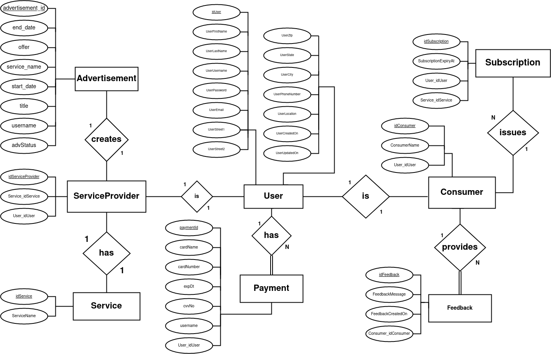
Servicegenerale’s
Conceptual
Entity-Relational
Diagram
Release: 2
Iteration: 4
Week: 14
Team: 3

Slide 2
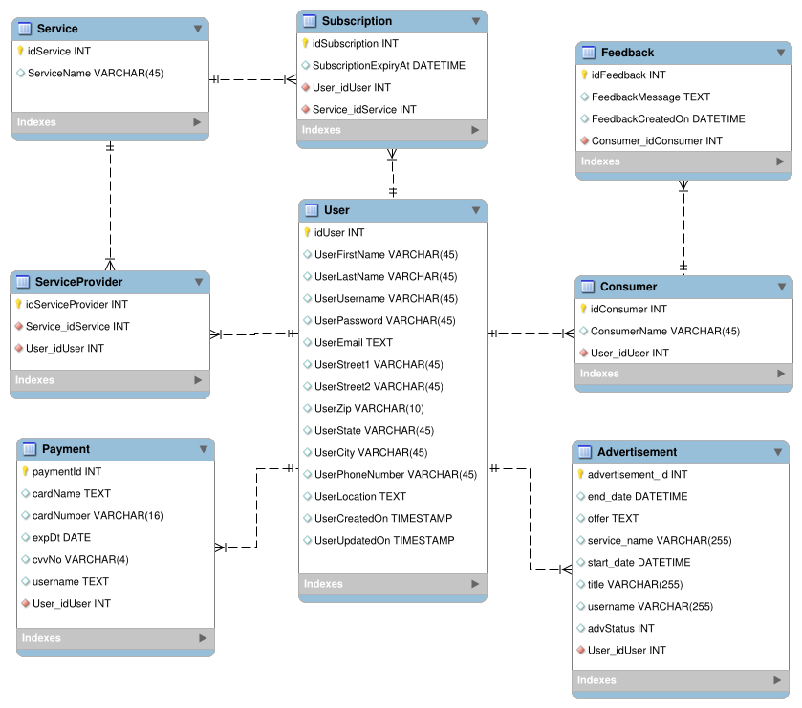
Servicegenerale’s
Logical
Entity-Relational
Diagram
Release: 2
Iteration: 4
Week: 14
Team: 3

